Slide 1
Digestive System Neoplasms
Maeve Lin
Ann-Léonie Beck
Katarzyna Speichert

Slide 2
Digestive System Neoplasms:
Gastric
Colorectal
Esophageal
Liver
Pancreatic
68.5 % older adults
Digestive System Neoplasms, BIO 392
Notes:
Among digestive system neoplasms we distinguish gastric cancer, colorectal cancer, esophageal cancer, liver cancer and pancreatic cancer. Most frequently affected group is the group of older adults which account for 68.5%.

Slide 3
Pancreatic cancer
1.8% of all cancers => 4.6% of cancer-related death
Pancreatic ductal adenocarcinoma (PDAC): 90% of all exocrine pancreatic cancers
PDAC: median survival rate < 6 months; 5-year survival rate ~10%
C-Myc overexpression in 43.5%
Digestive System Neoplasms, BIO 392
Notes:
1.8% of all cancers and is responsible for 4.6% of cancer-related death
Pancreatic ductal adenocarcinoma is the most common form of pancreatic cancer and accounts for 90% of all exocrine pancreatic cancers
Pancreatic ductal adenocarcinoma (PDAC) continues to be a lethal cancer with very bad prognosis , with a median survival rate is less than 6 months and a 5-year survival rate of only 10%
C-Myc overexpression in 43.5%

Slide 4
Aims
What is the frequnecy of each cancer type?
What are the most frequent types of digestive system neoplasms according to TNM classification?
Are there often deletions in tumor suppresion genes: TP53, CDKN2A?
Are there often duplications in tumor oncogenes: MYC, ERBB2?
What is the survival probability at different time point:
For the different genes
For the different organs
Digestive System Neoplasms, BIO 392

Slide 5
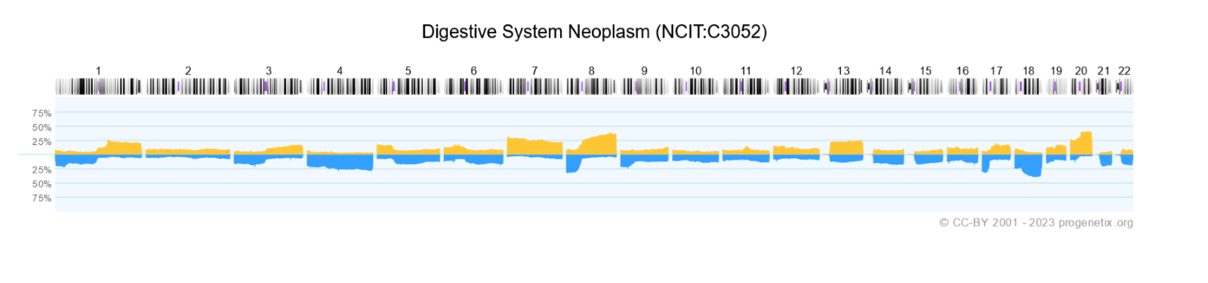
CNVs in Digestive System Neoplasms
Digestive System Neoplasms, BIO 392
Notes:
MYC: oncogene --> a duplication affects the probabilty of cancer, on chromosome 8 (q24 -> qter)
ERBB2:oncogene on chromosome 17q
TP53: tumor-suppressor gene, on chromosome 17 (17p13)
Duplication: special
Deletion
CDKN2A: tumor-suppressor gene, on chromosome 9, band p21
Frequent gains on: 7p, 8q, 20q
Frequent losses on: 4q, 8p, 17p, 18q
Cut-off 25%
In the CNV plot for Digestive System Neoplasms from progenetix we could identify frequent qains on 8q which could correspond to the MYC gene and frequent losses on the p arm of chromosom 17, which could correspond to gene TP53

Slide 6
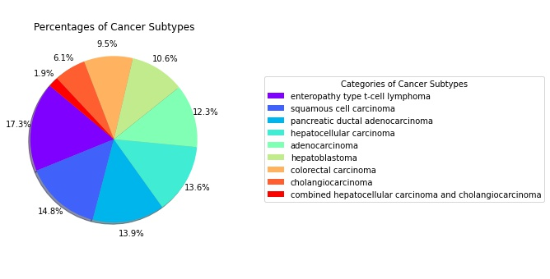
Percentages of different cancer subtypes
Digestive System Neoplasms, BIO 392
Notes:
Adenocarcinoma: tumor from the epithelium of glands (in organs, e.g. colon, esophagus, pancreas)
Enteropathy-type t-cell lymphoma: rare type of non-Hodgkin lymphoma
More common in european men
Enteropathy: chronic damage, irritation or swelling of small intestine (e.g. celiac disease)
Pancreatic ductal adenocarcinoma: we showed you pancreatic cancer before, survival is bad and it is quite common
Cholangiocarcinoma: bile duct
Hepatoblastoma: infants and children (2months – 3years)
Most common kind of liver cancer in children
Hepatocellular carcinoma: children 10-16y

Slide 7
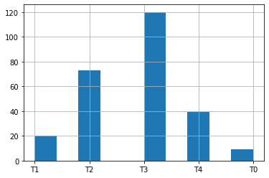
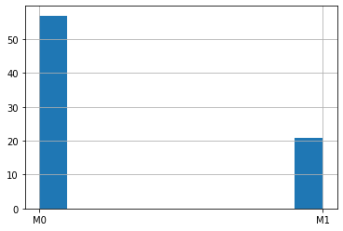
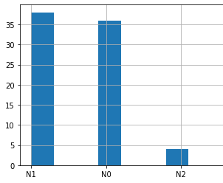
TNM classification
Frequency of cases
Size of primary tumor
Stage of metastases
Stage of lymph node invasion
Digestive System Neoplasms, BIO 392
Notes:
We see that the most frequent tumor size is T3, the second to biggest size
Metastases are not that frequent
Spread and no spread to regional lymph nodes is equally frequent

Slide 8
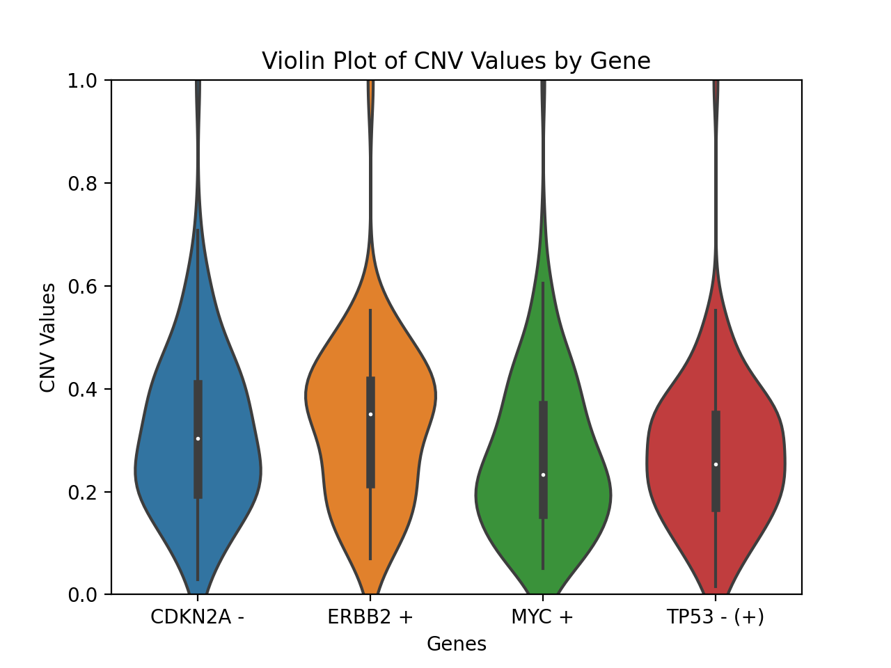
CNV fractions per gene
Digestive System Neoplasms, BIO 392
Notes:
Violin plot of CNV fractions by genes
What plus and minus means
On the violin plot can see that the mutation load is higher for ERBB2 than for the other genes.

Slide 9
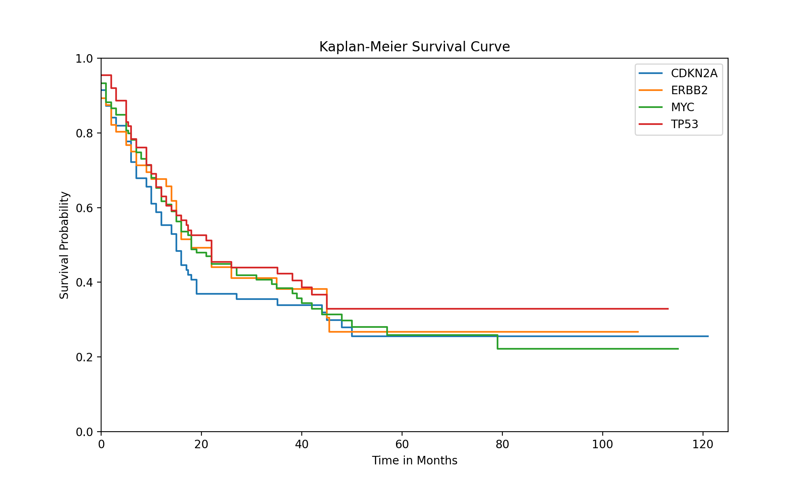
Survival rate based on affected genes
Digestive System Neoplasms, BIO 392
Notes:
CDKN2A has the worst prognosis. Steepest downfall in the first 20 months of entry into the study (probability to survive longer than 20 months is lower than 40%). In the long run is overtaken by MYC
At around 38 months TP53 has the best prognosis, with around 40% survival chance
At around 42 months ERBB2 has the best prognosis at around 38% but falls down to 22% in the matter of few months
Overall TP53 has the highest survival probability

Slide 10
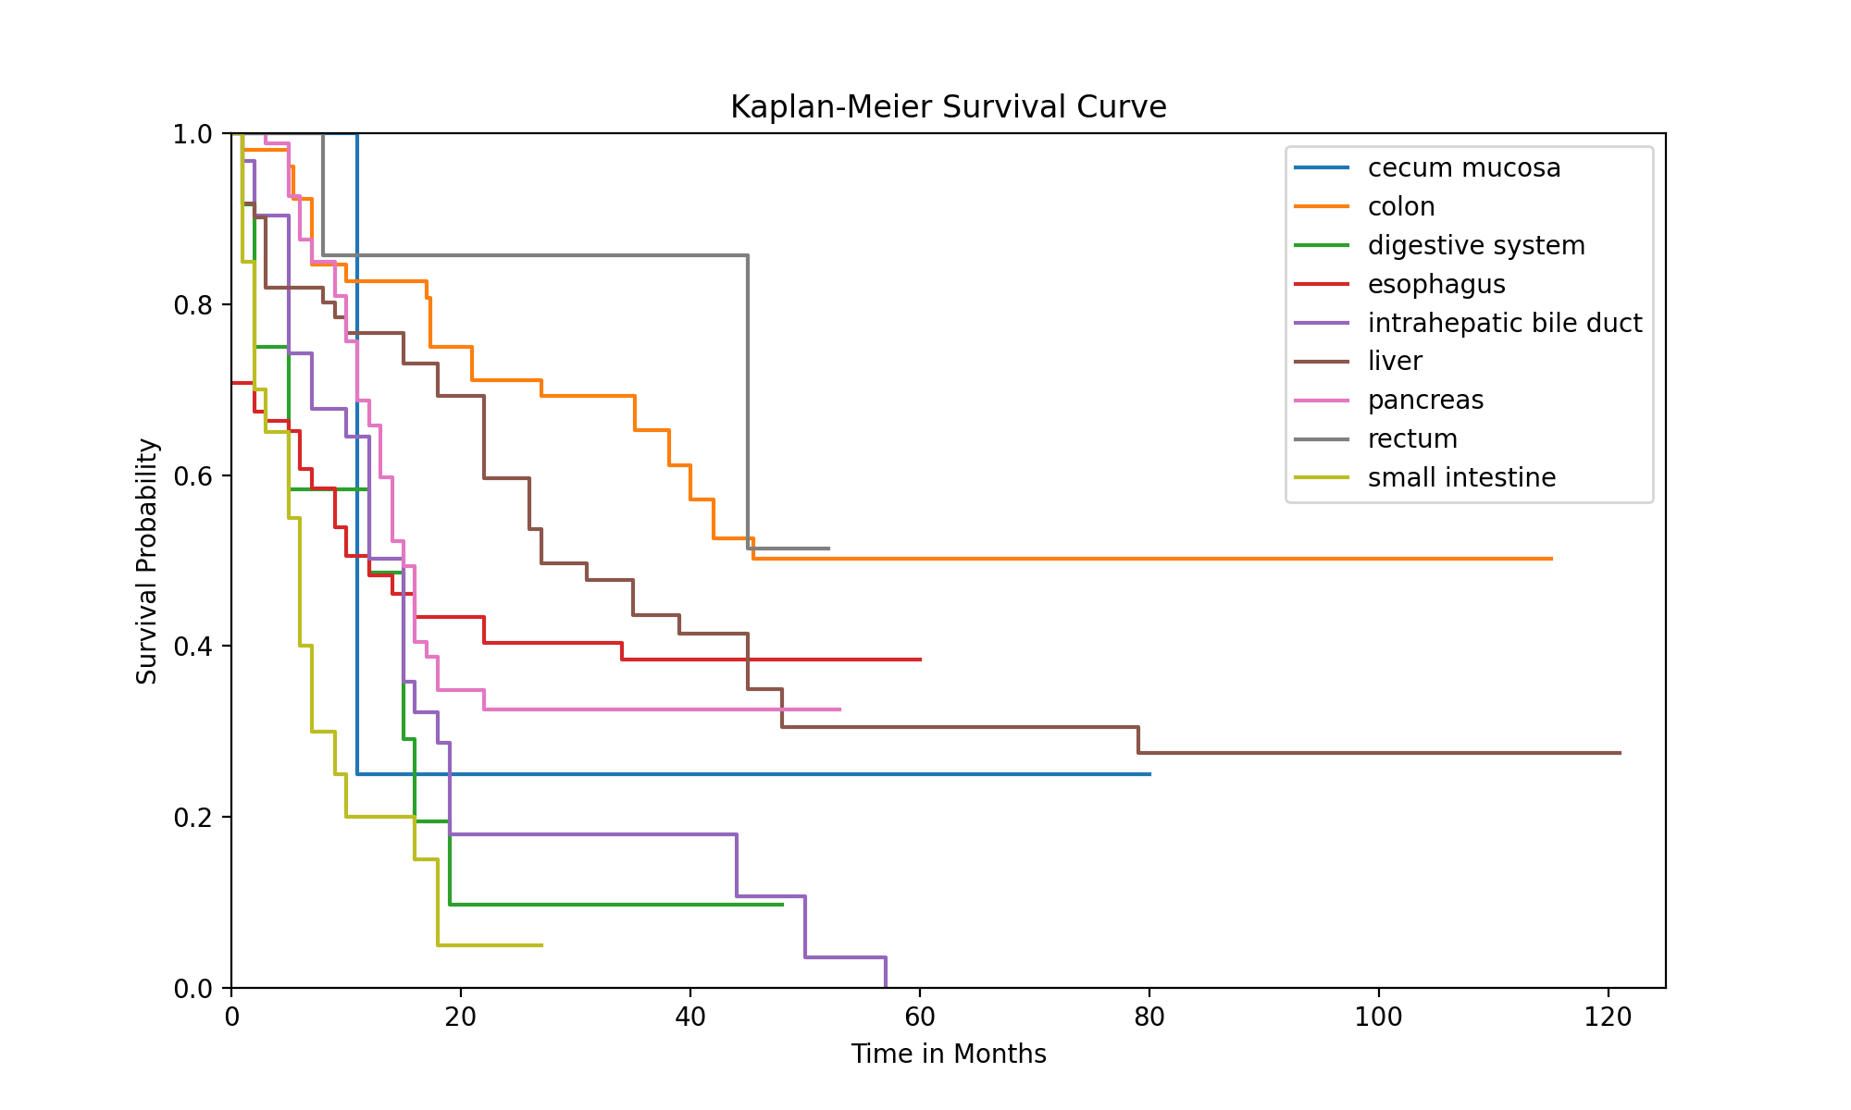
Survival rate based on affected organs
Digestive System Neoplasms, BIO 392
Notes:
Those are not the cancer type, but the sample tissues. Took this for better representation and vizualization
Sample size is not the same for every tissue eg. Cecum mucose which has around 1-2 samples
Cancer related to Small intestine samples have the fastest downfall in the survival probability, with around 4% survival probability after the first 20 months

Slide 11
Conclusions
The most frequent subtype is enteropathy-type t-cell lymphoma
Typical tumor: T3M0N1
ERBB2 has the highest mutation load
But it has one of the highest survival rates in the initial stages
And falls down really fast
Low survival rate in general
CDKN2A leads to the most aggressive tumor
Cancers related to small intestine tissues sample have the worst survival rate
Cancers related to rectum cancer tissue samples have the best survival probability (small sample size, frequency)

Slide 12
References
Ala M. Target c-Myc to treat pancreatic cancer. Cancer Biol Ther. 2022 Dec 31;23(1):34-50. doi: 10.1080/15384047.2021.2017223. Epub 2022 Jan 3. PMID: 34978469; PMCID: PMC8812741.
Kimura H, Klein AP, Hruban RH, Roberts NJ. The Role of Inherited Pathogenic CDKN2A Variants in Susceptibility to Pancreatic Cancer. Pancreas. 2021 Sep 1;50(8):1123-1130. doi: 10.1097/MPA.0000000000001888. PMID: 34714275; PMCID: PMC8562885.
Digestive System Neoplasms, BIO 392

